Slide 1
Memory Devices (Part-1)
Md. Azmain Yakin Srizon
Lecturer, Dept. of CSE, RUET

Slide 2
Modules
Module-1: Introduction
Module-2: Memory Terminology
Module-3: General Memory Operations
Module-4: CPU-Memory Connections

Slide 3
Module-1
Introduction

Slide 4
Introduction
Flip-flops, also called as registers, are commonly used types of memory devices and systems
Digital data can also be stored as charges on capacitors
The principle is to obtain high density storage at low power-requirement levels

Slide 5
Main Memory
Semiconductor memories are used as the main memory of a computer
It’s used where fast operation is important
It’s also called working memory
It is in constant communication with the central processing unit (CPU) as a program of instructions is being executed.
It works with a program and any data used by the program
RAM and ROM make up main memory.

Slide 6
Auxiliary Memory
Another form of storage in a computer is performed by auxiliary memory
It is also called mass storage – has the capacity to store massive amounts of data without the need for electrical power
Auxiliary memory operates at a much slower speed than main memory
It stores programs and data that are not currently being used by the CPU
This information is transferred to the main memory when the computer needs it
Common auxiliary memory devices are magnetic disk and compact disk (CD)

Slide 7
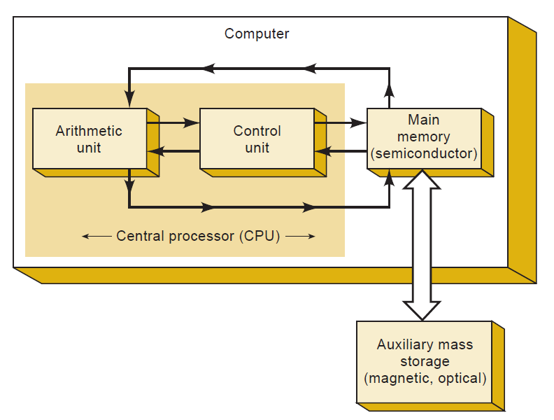
Computer Memories
Fig. 1.1: A computer system normally uses highspeed main memory and slower external auxiliary memory.

Slide 8
Module-2
Memory Terminology

Slide 9
Memory Cell
A device or an electrical circuit used to store a single bit (0 or 1)
Examples of memory cells include a flip-flop, a charged capacitor, and a single spot on magnetic tape or disk
1
Fig. 2.1: Memory Cell Representation

Slide 10
Memory Word
A group of bits (cells) in a memory that represents instructions or data of some type.
For example, a register consisting of eight FFs can be considered to be a memory that is storing an eight-bit word.
Word sizes in modern computers typically range from 8 to 64 bits, depending on the size of the computer.
1
0
0
1
1
0
1
0
Fig. 2.2: Memory Word Representation for 8 bits computer
1
0
0
1
1
0
0
1
1
0
1
0
1
0
1
0
Fig. 2.3: Memory Word Representation for 16 bits computer

Slide 11
Byte
A byte always consists of eight bits
Word sizes can be expressed in bytes as well as in bits
For example, a word size of eight bits is also a word size of one byte, a word size of 16 bits is two bytes, and so on
1
0
0
1
1
0
1
0
Fig. 2.3: Representation of a byte (8 bits)

Slide 12
Capacity
A way of specifying how many bits can be stored in a particular memory device or complete memory system.
To illustrate, suppose that we have a memory that can store 4096 20-bit words. This represents a total capacity of 81,920 bits.
It is common to use the designation “1K” to represent 1024

Slide 13
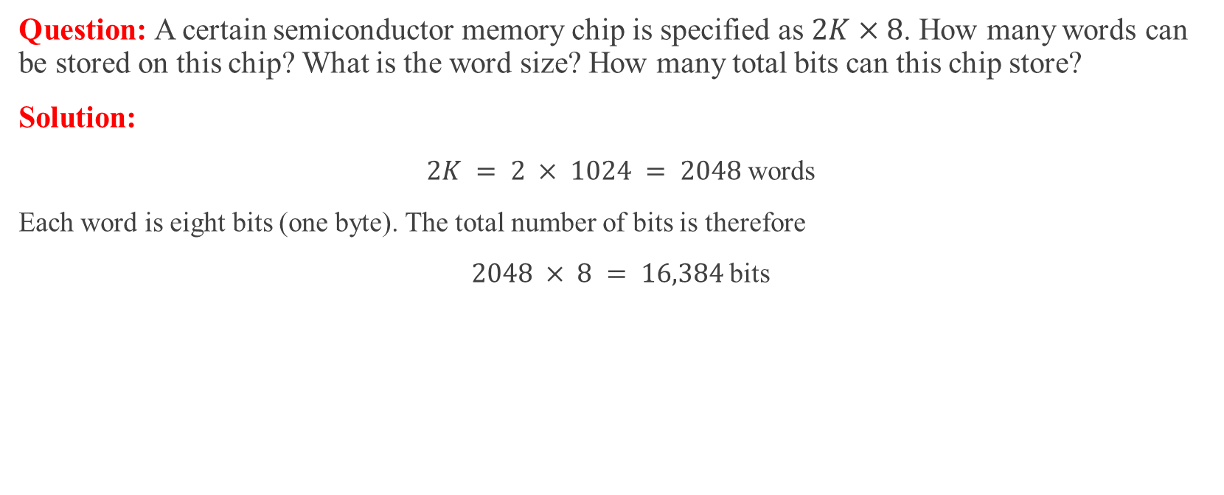
Example 2.1
Question: A certain semiconductor memory chip is specified as $2K×8$. How many words can be stored on this chip? What is the word size? How many total bits can this chip store?
Solution:
$2K = 2 × 1024 = 2048$words
Each word is eight bits (one byte). The total number of bits is therefore
$2048 × 8 = 16,384$bits

Slide 14
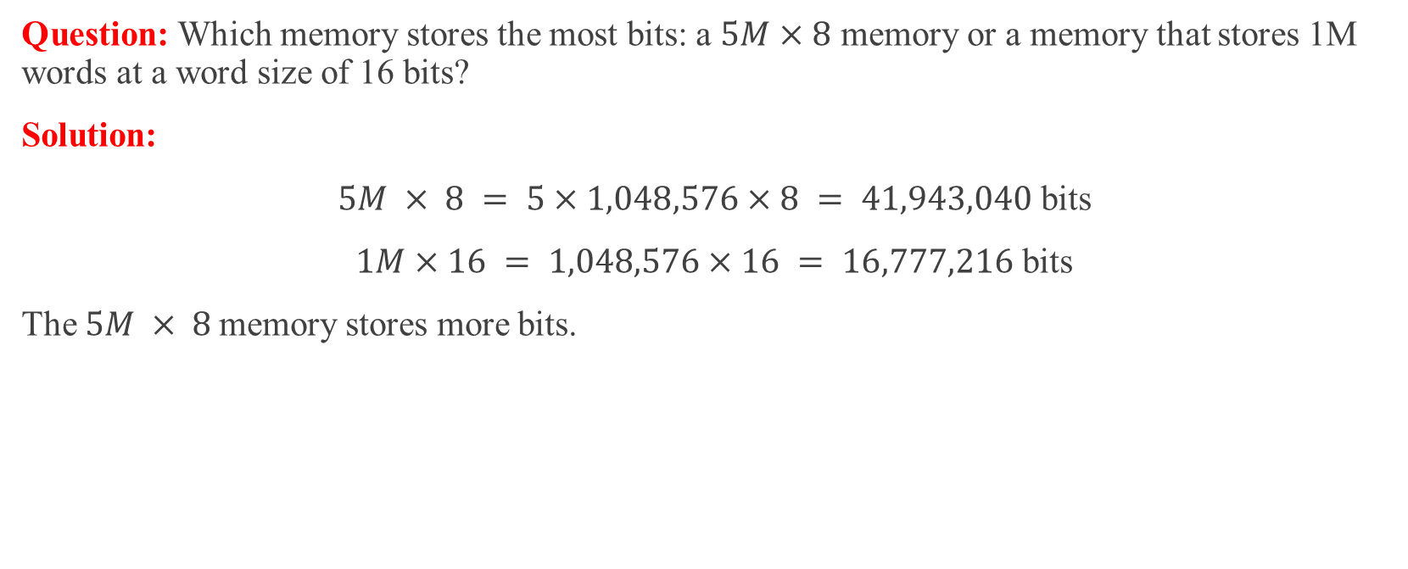
Example 2.2
Question: Which memory stores the most bits: a $5M×8$ memory or a memory that stores 1M words at a word size of 16 bits?
Solution:
$5M × 8 = 5×1,048,576×8 = 41,943,040$ bits
$1M×16 = 1,048,576×16 = 16,777,216$ bits
The $5M × 8$memory stores more bits.

Slide 15
Density
Another term for capacity.
When we say that one memory device has a greater density than another, we mean that it can store more bits in the same amount of space.

Slide 16
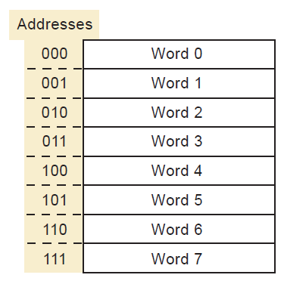
Address
A number that identifies the location of a word in memory.
Each word stored in a memory device or system has a unique address.
Addresses always exist in a digital system as a binary number, although octal, hexadecimal, and decimal numbers are often used to represent the address for convenience.
Fig 2.4: Each word location has a specific binary address.

Slide 17
Read Operation
The operation whereby the binary word stored in a specific memory location (address) is sensed and then transferred to another device.
The read operation is often called a fetch operation because a word is being fetched from memory.

Slide 18
Write Operation
The operation whereby a new word is placed into a particular memory location.
It is also referred to as a store operation.
Whenever a new word is written into a memory location, it replaces the word that was previously stored there.

Slide 19

Access Time
A measure of a memory device’s operating speed.
It is the amount of time required to perform a read operation.
More specifically, it is the time between the memory receiving a new address input and the data becoming available at the memory output.
The symbol $t_{ACC}$ is used for access time.

Slide 20
Volatile and Non-volatile Memories
Any type of memory that requires the application of electrical power in order to store information.
If the electrical power is removed, all information stored in the memory will be lost.
Many semiconductor memories are volatile, while all magnetic memories are nonvolatile, which means that they can store information without electrical power.

Slide 21
Random-Access Memory (RAM)
Memory in which the actual physical location of a memory word has no effect on how long it takes to read from or write into that location.
In other words, the access time is the same for any address in memory.
Most semiconductor memories are RAMs.

Slide 22
Sequential-Access Memory (SAM)
A type of memory in which the access time is not constant but varies depending on the address location.
A particular stored word is found by sequencing through all address locations until the desired address is reached.
This produces access times that are much longer than those of random-access memories.
An example of a sequential-access memory device is a magnetic tape backup.

Slide 23
Read/Write Memory (RWM)
Any memory that can be read from or written into with equal ease.
Has both functionality of reading and writing.

Slide 24
Read-Only Memory (ROM)
A broad class of semiconductor memories designed for applications where the ratio of read operations to write operations is very high.
Technically, a ROM can be written into (programmed) only once, and this operation is normally performed at the factory.
Thereafter, information can only be read from the memory.
Other types of ROM are actually read-mostly memories (RMM), which can be written into more than once; but the write operation is more complicated than the read operation, and it is not performed very often.
All ROM is nonvolatile and will store data when electrical power is removed.

Slide 25
Static Memory Devices
Semiconductor memory devices in which the stored data will remain permanently stored as long as power is applied,
without the need for periodically rewriting the data into memory.

Slide 26
Dynamic Memory Devices
Semiconductor memory devices in which the stored data will not remain permanently stored, even with power applied, unless the data are periodically rewritten into memory.
The latter operation is called a refresh operation.

Slide 27
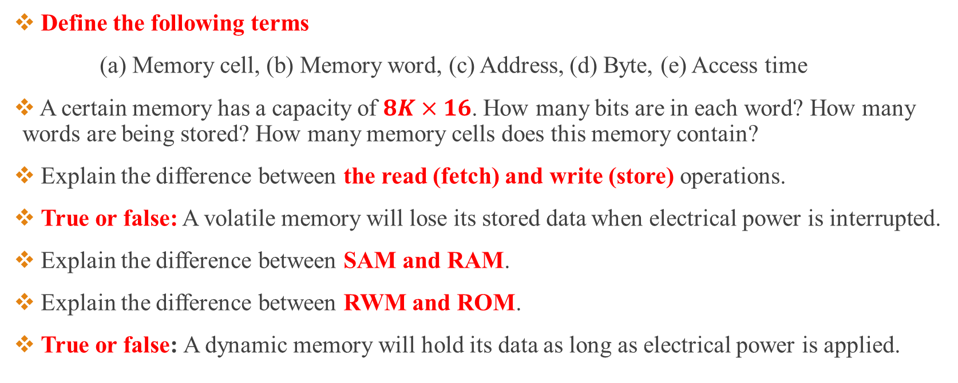
Review Questions
Define the following terms
(a) Memory cell, (b) Memory word, (c) Address, (d) Byte, (e) Access time
A certain memory has a capacity of $8K×16$. How many bits are in each word? How many words are being stored? How many memory cells does this memory contain?
Explain the difference between the read (fetch) and write (store) operations.
True or false: A volatile memory will lose its stored data when electrical power is interrupted.
Explain the difference between SAM and RAM.
Explain the difference between RWM and ROM.
True or false: A dynamic memory will hold its data as long as electrical power is applied.

Slide 28
Module-3
General Memory Operations

Slide 29
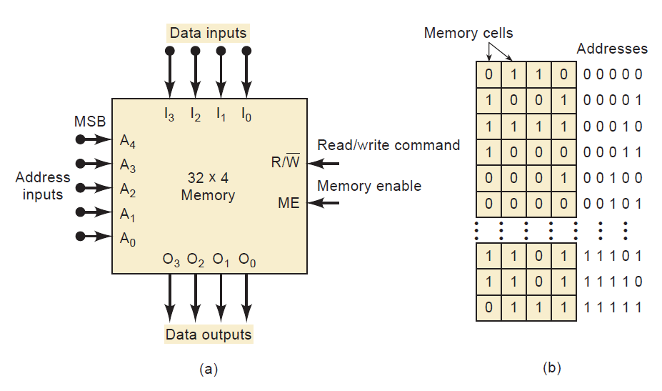
Sample Memory Illustration
Fig 3.1: (a) Diagram of a $32×4$ Memory, (b) virtual arrangement of memory cells into 32 four-bit words.

Slide 30
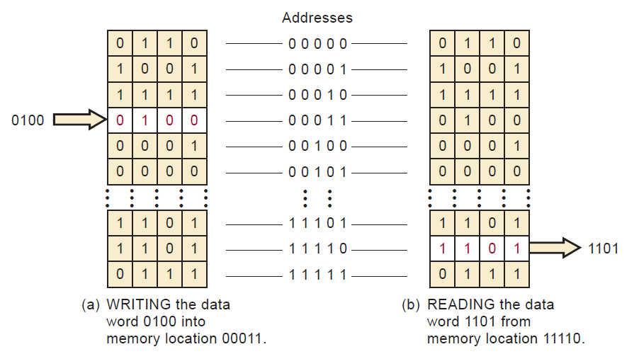
Simplified Reading-Writing Operations
Fig 3.2: Simplified Reading-Writing Operations

Slide 31
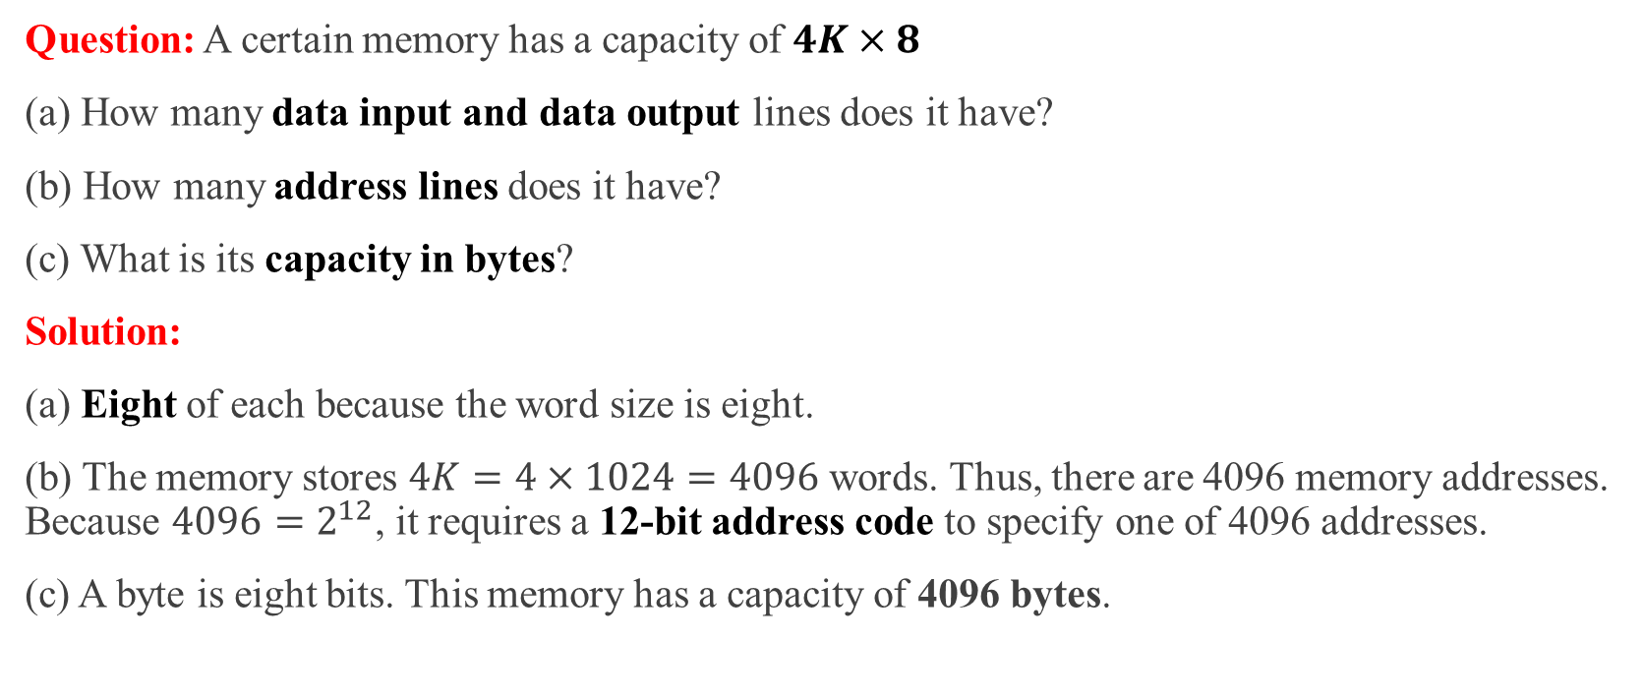
Example 3.1
Question: A certain memory has a capacity of $4K×8$
(a) How many data input and data output lines does it have?
(b) How many address lines does it have?
(c) What is its capacity in bytes?
Solution:
(a) Eight of each because the word size is eight.
(b) The memory stores $4K=4×1024=4096$words. Thus, there are 4096 memory addresses. Because $4096=2^{12}$, it requires a 12-bit address code to specify one of 4096 addresses.
(c) A byte is eight bits. This memory has a capacity of 4096 bytes.

Slide 32

Review Questions
How many address inputs, data inputs, and data outputs are required for a $16K×12$ memory?
What is the function of the $R/\overline{W}$ input?
What is the function of the MEMORY ENABLE input?

Slide 33
Module-4
CPU-Memory Connections

Slide 34
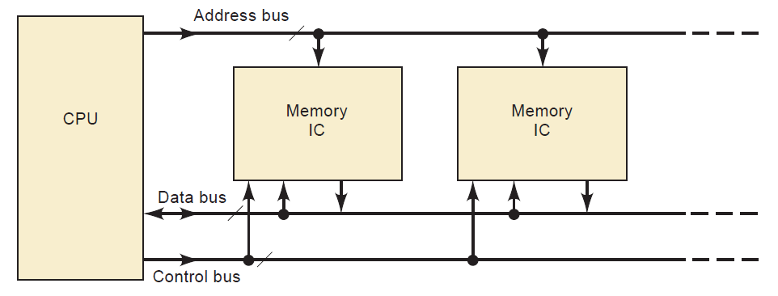
Bus Connections
Fig 4.1: Three groups of lines (buses) connect the main memory ICs to the CPU.

Slide 35
Different Buses
Address Bus: This unidirectional bus carries the binary address outputs from the CPU to the memory ICs to select one memory location.
Data Bus: This bidirectional bus carries data between the CPU and the memory ICs.
Control Bus: This bus carries control signals (such as the signal Read or Write signal) from the CPU to the memory ICs.

Slide 36
Review Questions
Name the three groups of lines that connect the CPU and the internal memory.
Outline the steps that take place when the CPU reads from memory.
Outline the steps that occur when the CPU writes to memory.

Slide 37
References
Digital Systems by Tocci, Widmer, Moss
Chapter 12: Memory Devices (12.1-12.3)
Pages: 785-794

Slide 38
Thank You
Next Topics
Read-Only Memory

